Slide 1
Lesson 7
PHP-OOP
1

Slide 2
Introduction
OOP stands for Object-Oriented Programming.
Procedural programming is about writing procedures or functions that perform operations on the data, while object-oriented programming is about creating objects that contain both data and functions.

Slide 3
Advantages of OOP
Object-oriented programming has several advantages over procedural programming:
  OOP is faster and easier to execute
  OOP provides a clear structure for the programs
  OOP helps to keep the PHP code DRY "Don't Repeat Yourself", and makes the code easier to maintain, modify and debug
  OOP makes it possible to create full reusable applications with less code and shorter development time

Slide 4
PHP Classes and Objects
A class is a template for objects, and an object is an instance of class.
Let's assume we have a class named Fruit. A Fruit can have properties like name, color, weight, etc.
We can define variables like $name, $color, and $weight to hold the values of these properties.
When the individual objects (apple, banana, etc.) are created, they inherit all the properties and behaviors from the class, but each object will have different values for the properties.

Slide 5
PHP Classes and Objects
When the individual objects (apple, banana, etc.) are created, they inherit all the properties and behaviors from the class, but each object will have different values for the properties.

Slide 6
Define a Class
A class is defined by using the class keyword, followed by the name of the class and a pair of curly braces ({}).
All its properties and methods go inside the braces:
Syntax
<?php
class Fruit {
// code goes here...
}
?>

Slide 7
Define a Class(cont.)
Below we declare a class named Fruit consisting of two properties ($name and $color) and two methods set_name() and get_name() for setting and getting the $name property:

Slide 8
Define a Class(cont.)
<?php
class Fruit {
// Properties
public $name;
public $color;
// Methods
function set_name($name) {
$this->name = $name;
}
function get_name() {
return $this->name;
}
}
?>

Slide 9
Define Objects
Classes are nothing without objects! We can create multiple objects from a class. Each object has all the properties and methods defined in the class, but they will have different property values.
Objects of a class are created using the new keyword.
In the example below, $apple and $banana are instances of the class Fruit:

Slide 10
Define Objects(cont.)
<?php
class Fruit {
// Properties
public $name;
public $color;
// Methods
function set_name($name) {
$this->name = $name;
}
function get_name() {
return $this->name;
}
}
$apple = new Fruit();
$banana = new Fruit();
$apple->set_name('Apple');
$banana->set_name('Banana');
echo $apple->get_name();
echo "<br>";
echo $banana->get_name();
?>

Slide 11
Define Objects(cont.)
In the example below, we add two more methods to class Fruit, for setting and getting the $color property:
<?php
class Fruit {
// Properties
public $name;
public $color;
// Methods
function set_name($name) {
$this->name = $name;
}
function get_name() {
return $this->name;
}
function set_color($color) {
$this->color = $color;
}
function get_color() {
return $this->color;
}
}
$apple = new Fruit();
$apple->set_name('Apple');
$apple->set_color('Red');
echo "Name: " . $apple->get_name();
echo "<br>";
echo "Color: " . $apple->get_color();
?>
Output
Name: Apple
Color: Red
[see classes-objects-1.php]

Slide 12
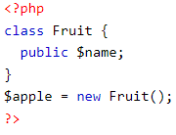
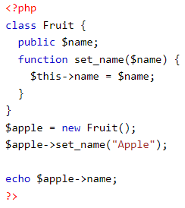
PHP $this Keyword
The $this keyword refers to the current object, and is only available inside methods.
Look at the following example:
1
3
2
So, where can we change the value of the $name property? There are two ways:
1. Inside the class (by adding a set_name() method and use $this):

Slide 13
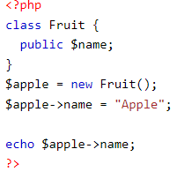
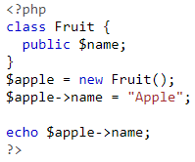
PHP $this Keyword(cont.)
2. Outside the class (by directly changing the property value):
Look at the following example:
1
2

Slide 14
PHP instanceof
You can use the instanceof keyword to check if an object belongs to a specific class:
Example
<?php
$apple = new Fruit();
var_dump($apple instanceof Fruit);
?>

Slide 15
PHP OOP - Constructor
A constructor allows you to initialize an object's properties upon creation of the object.
If you create a __construct() function, PHP will automatically call this function when you create an object from a class.
Notice that the construct function starts with two underscores (_ _)!
We see in the example below, that using a constructor saves us from calling the set_name() method which reduces the amount of code:

Slide 16
PHP OOP Constructor(cont.)
<?php
class Fruit {
public $name;
public $color;
function __construct($name) {
$this->name = $name;
}
function get_name() {
return $this->name;
}
}
$apple = new Fruit("Apple");
echo $apple->get_name();
?>

Slide 17
PHP - The __destruct Function
A destructor is called when the object is destructed or the script is stopped or exited.
If you create a __destruct() function, PHP will automatically call this function at the end of the script.
Notice that the destruct function starts with two underscores (__)!
The example below has a __construct() function that is automatically called when you create an object from a class, and a __destruct() function that is automatically called at the end of the script:

Slide 18
PHP - Access Modifiers
Properties and methods can have access modifiers which control where they can be accessed.
There are three access modifiers:
  public - the property or method can be accessed from everywhere. This is default
  protected - the property or method can be accessed within the class and by classes derived from that class
  private - the property or method can ONLY be accessed within the class

Slide 19
PHP - Access Modifiers(cont.)
In the following example we have added three different access modifiers to three properties (name, color, and weight).
Here, if you try to set the name property it will work fine (because the name property is public, and can be accessed from everywhere).
However, if you try to set the color or weight property it will result in a fatal error (because the color and weight property are protected and private):

Slide 20
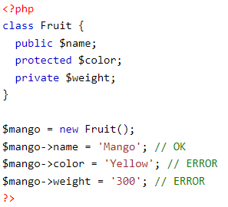
PHP - Access Modifiers(cont.)

Slide 21
PHP - Access Modifiers(cont.)
In the next example we have added access modifiers to two functions.
Here, if you try to call the set_color() or the set_weight() function it will result in a fatal error (because the two functions are considered protected and private), even if all the properties are public:

Slide 22
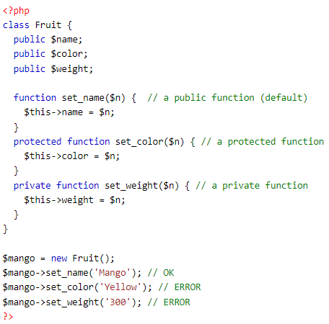
PHP - Access Modifiers(cont.)

Slide 23
PHP OOP Inheritance
Inheritance in OOP = When a class derives from another class.
The child class will inherit all the public and protected properties and methods from the parent class. In addition, it can have its own properties and methods.
An inherited class is defined by using the extends keyword.

Slide 24
PHP OOP Inheritance(cont.)
The Strawberry class is inherited from the Fruit class.
This means that the Strawberry class can use the public $name and $color properties as well as the public __construct() and intro() methods from the Fruit class because of inheritance.
The Strawberry class also has its own method: message().

Slide 25
THE END
Thank you!

